Slide 1
Heart Disease Prediction
Group 1 Mid Term Assignment
Aarushi Pandey, Karthikeyan Mohan, Robin Chabra, Yugandhar Kumar Savalam

Slide 2
Table of contents
Introduction
Approach
Dataset explanation
Data Visualization
Data cleaning
Feature Engineering
Data Modeling and Evaluation
Deployment in cloud

Slide 3
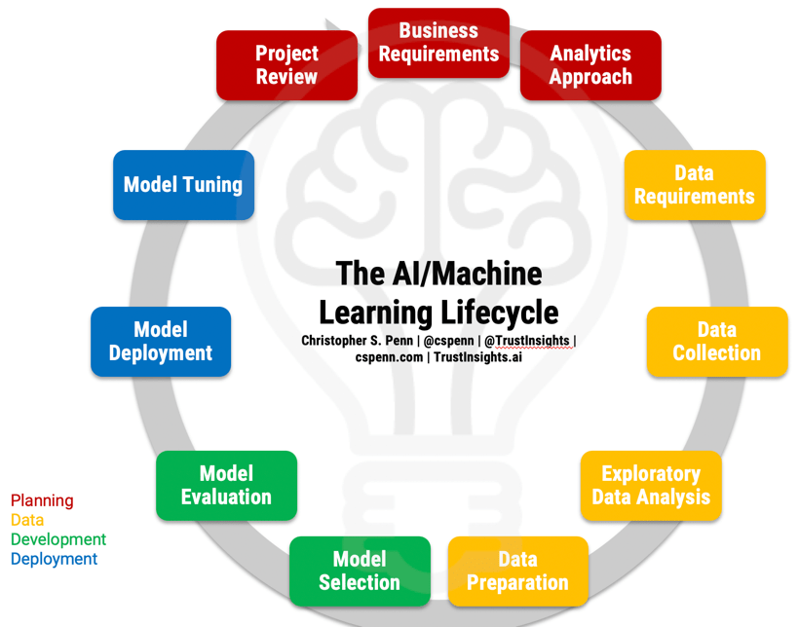
Introduction
Cleveland dataset consists of 14 fields. We need to build the machine learning model to predict the heart disease of the patient.
We need to perform the entire machine learning process to develop the model.
This Photo by Unknown Author is licensed under CC BY-NC-ND

Slide 4
Approach :
Import and read the dataset
Visualize using Power BI to understand the relations between attributes.
Data Cleaning using pandas and NumPy to remove null and special characters in the dataset.
Feature engineering and split the dataset for test and train.
Build the model based on the data class.
Evaluates and find accuracy to select the best algorithm.
Test the model with input from user data.
Create an interactive web application using Flask
Use EC2 instance to host the web application and run it from other machines.

Slide 5
Dataset :
Dataset consist of 303 records and 76 characteristics .
Age: Patient age in years
Sex : Patient gender description (1 = male, 0 = female)
Cp : Type of chest pain Patient suffering ( Typical Angina = 1, Atypical Angina = 2, Non-anginal pain = 3, Asymptomatic = 4).
Trestbps: Normal blood pressure in mm Hg (<120/80).
Chol: Amount of HDL and LDL in blood (< 200 mg/dl).
Fbs: Blood sugar level after overnight fasting >120 mg/dl. (Yes =1, No = 0).
Restecg : Resting electrographic result ( 0 = normal, 1 = having ST-T wave abnormality, 2 = showing probable or define left ventricular hypertrophy by Estes' criteria.
Thalach : Maximum heartbeat rate.
Exang : Feels angina during physical activity ( yes = 1, no = 0).
Old peak : ST depression value.
Slope : Type of slope ( 1 = UPSLOPING, 2 = HORIZONTAL, 3 = DOWN SLOPING).
Ca : Major vessel covered by fluoroscopy range (0-3).
Thal : Type of Thalassemia in Patient ( 3 = Normal, 6 = fixed defect, 7 = reversible defect.
Num : final targeted value, if present ( value 1,2,3,4) and absence (value 0).

Slide 6
Data Visualization
Data visualization is an integral part of any machine learning model. We used Power BI to visualize the data efficiently to understand each attribute and gained below insights :
The first visualization is the Count of age vs. Diagnosis of heart disease stacked column chart which depicts as compared to males, females are at less risk of heart disease.
Another visualization line and stacked column chart represent the relation between the Count of resting blood pressure and the Count of serum cholesterol by Age and Exercise-induced angina.
The pie chart of the Count of type of thalassemia vs Exercise-induced angina shows that people with complaints of exercise-induced angina show less Count of a type of thalassemia in comparison to people having no complaints of exercise-induced angina.
Line chart between Count of age by Slope of peak exercise ST-segment and Diagnosis of heart disease depicts slope of peak exercise segment having heart disease shows an upward and then a sharp downward trend while the slope of peak exercise segment with no heart disease shows a continuous downward trend.
With an increase in age, the sum of maximum heart rate achieved increases, and complaints of exercise-induced angina as well. This generalization can be drawn through a stacked area chart of Sum of maximum heart rate achieved by Age and Exercise-induced angina.
Visualization of Count of chest pain by Gender and Slope of the peak exercise ST segment is shown through a 100% stacked column chart that concludes that chest pain complaintsare more in males than females.

Slide 7
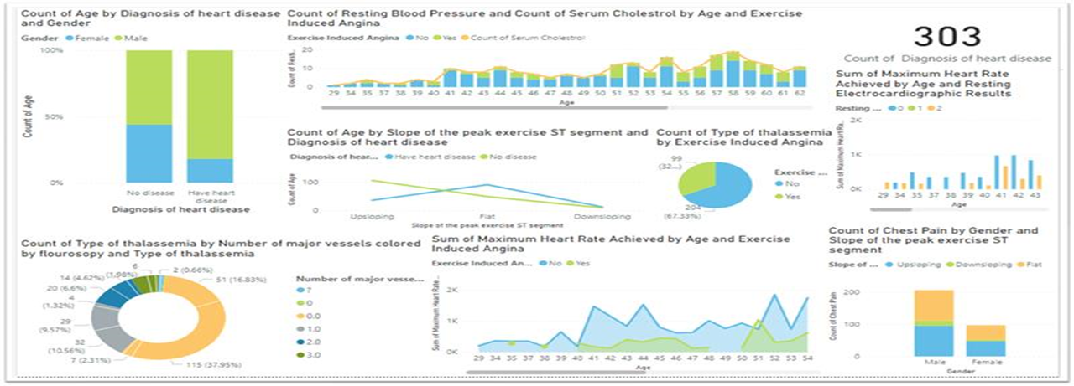
The donut chart represents the Count of type of thalassemia by the number of major vessels colored by fluoroscopy and type of thalassemia.
The Sum of maximum heart rate achieved by the number of major vessels colored by fluoroscopy and Resting Electrocardiographic results is visualized through clustered column chart.

Slide 8
Data Cleaning Feature Engineering
Checked if any null is present.
Checked if any special characters are present.
Identified the special character ‘?’ in the attributes 12 and 13.
Replaced it with Mode value.
Based on our analysis from visualisation, we identified that all the attributes are related are required for modelling. Hence we are going with all the attributes.
We have updated the target dataset from (0,1,2,3,4) to just two categorical values(0,1) to fit into the model.
We have split the dataset into test and training with the 80:20 ratio.

Slide 9
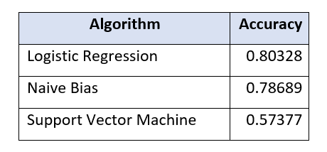
Data Modeling and Evaluation :
Since it’s a discrete output attribute, we have chosen a classification algorithm. We modelled with following three classification algorithms and choose the best one based on accuracy:

Slide 10
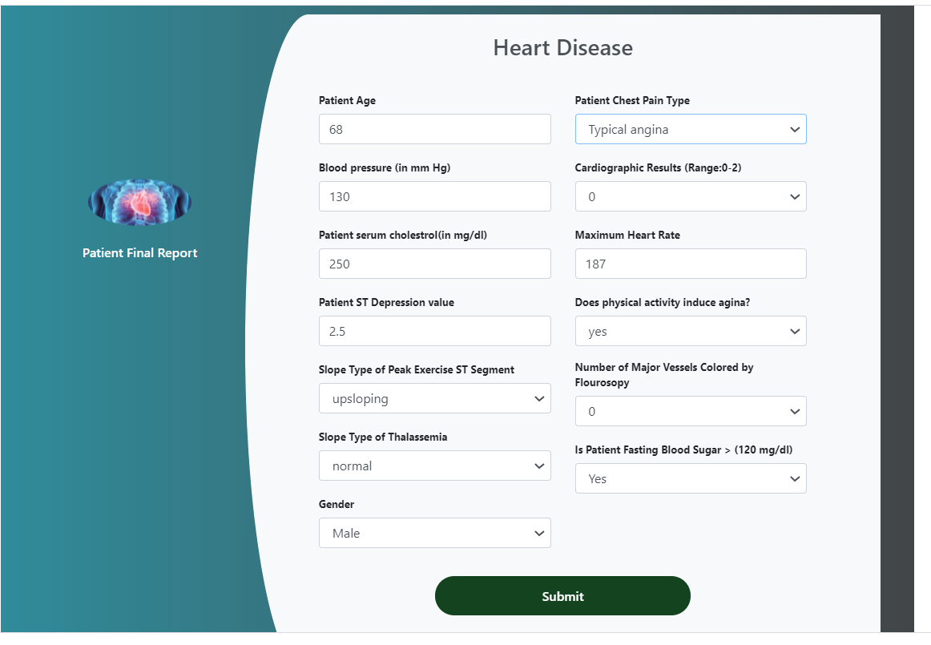
Deployment :
We created the web page using the HTML.
Then we combined the web page with our python code using Flask library.
Hosted locally to test the application.
We create an AWS accounts and created an instance.
Then we transferred our codes to cloud using the winscp and host the webserver in the EC2 instance.

Slide 11

This Photo by Unknown Author is licensed under CC BY

